Slide 1
Подводные камни k-means
(особенности кластеризации)

Slide 2
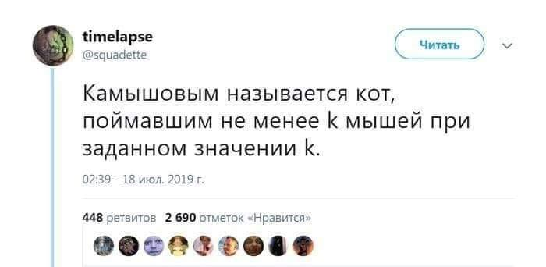

Slide 3
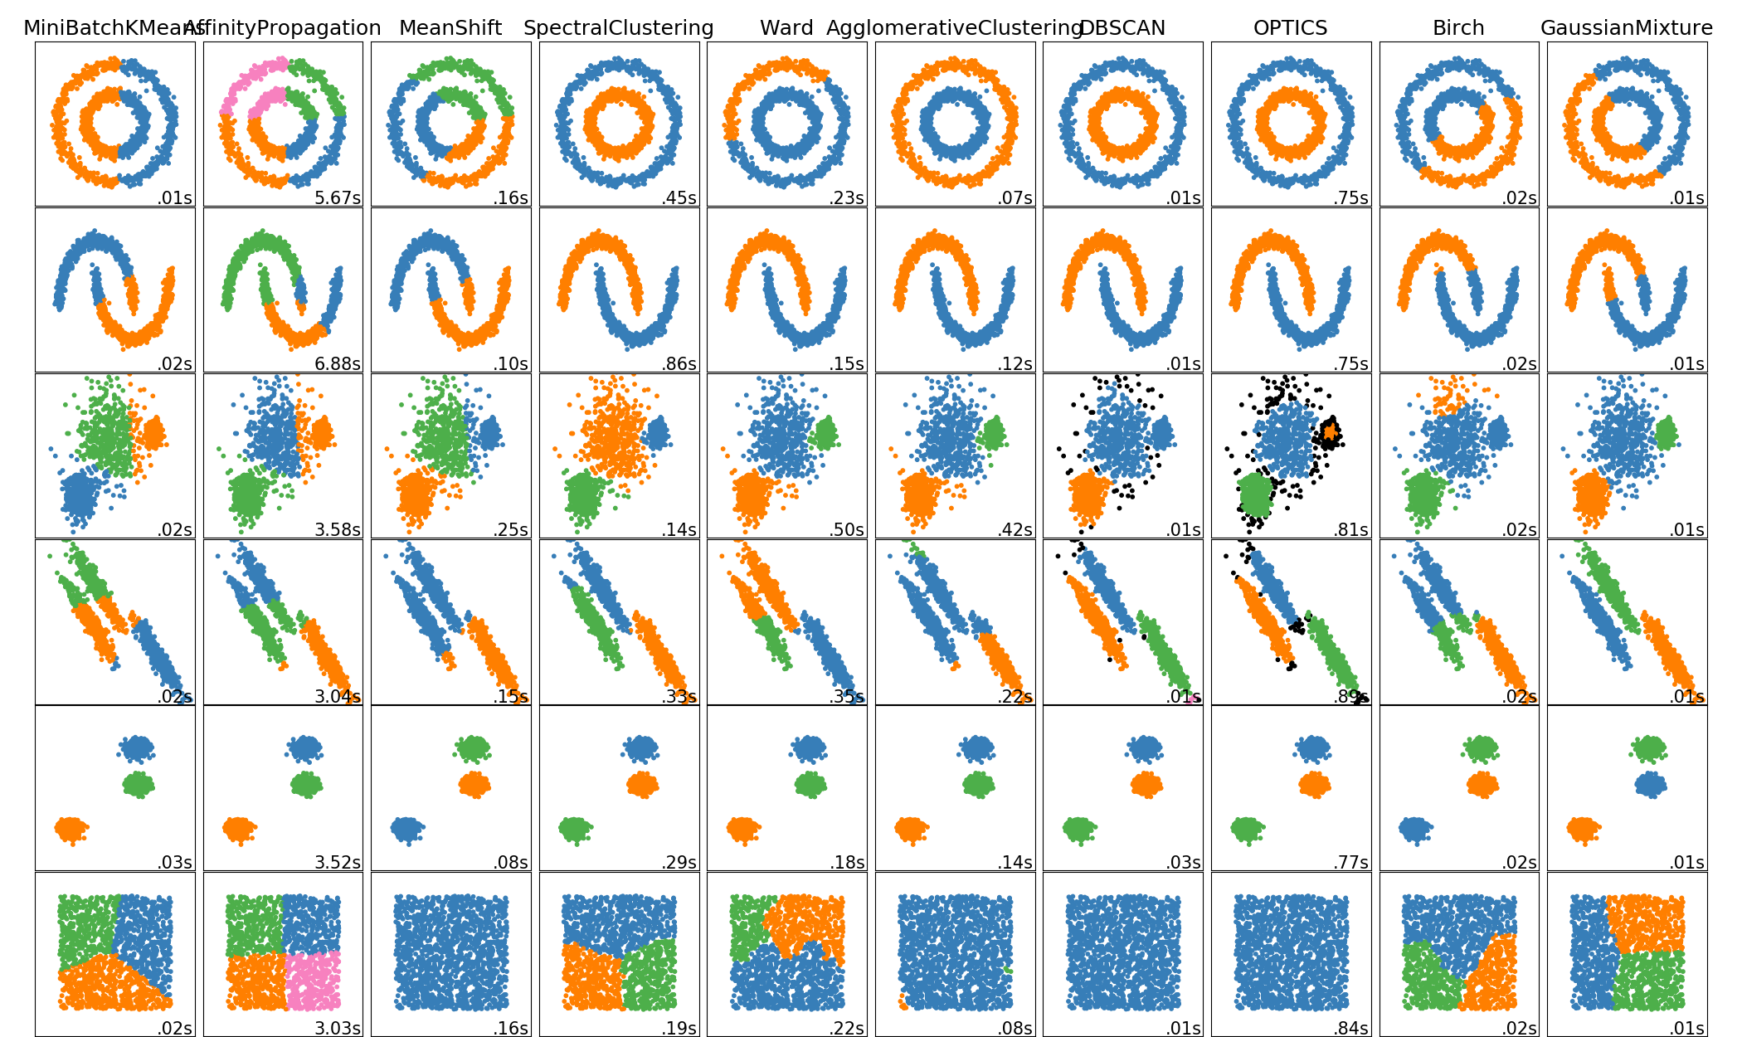

Slide 4
Method name | Parameters | Scalability | Use Case | Geometry (metric used)
K-Means | number of clusters | Very large n_samples, medium n_clusters with MiniBatch code | General-purpose, even cluster size, flat geometry, not too many clusters | Distances between points
Affinity propagation | damping, sample preference | Not scalable with n_samples | Many clusters, uneven cluster size, non-flat geometry | Graph distance (e.g. nearest-neighbor graph)
Mean-shift | bandwidth | Not scalable with n_samples | Many clusters, uneven cluster size, non-flat geometry | Distances between points
Spectral clustering | number of clusters | Medium n_samples, small n_clusters | Few clusters, even cluster size, non-flat geometry | Graph distance (e.g. nearest-neighbor graph)
Ward hierarchical clustering | number of clusters or distance threshold | Large n_samples and n_clusters | Many clusters, possibly connectivity constraints | Distances between points
Agglomerative clustering | number of clusters or distance threshold, linkage type, distance | Large n_samples and n_clusters | Many clusters, possibly connectivity constraints, non Euclidean distances | Any pairwise distance

Slide 5
Method name | Parameters | Scalability | Usecase | Geometry (metric used)
DBSCAN | neighborhood size | Very large n_samples, medium n_clusters | Non-flat geometry, uneven cluster sizes | Distances between nearest points
OPTICS | minimum cluster membership | Very large n_samples, large n_clusters | Non-flat geometry, uneven cluster sizes, variable cluster density | Distances between points
Gaussian mixtures | many | Not scalable | Flat geometry, good for density estimation | Mahalanobis distances to centers
Birch | branching factor, threshold, optional global clusterer. | Large n_clusters and n_samples | Large dataset, outlier removal, data reduction. | Euclidean distance between points

Slide 6
Небольшое сравнение
Метод | Скорость работы | Чувствительность к шуму в данных | Одинаковые данные | Автоматическое определение количества кластеров | Прочее
DBSCAN, HDBSCAN | 3 | + | + | +
k-Means | 1 | - | Error | - | SegmentationFault!!!
AgglomerativeClustering | 2 | - | + | + | Требовательный к памяти

Slide 7
Небольшое демо
k-Means
https://www.naftaliharris.com/blog/visualizing-k-means-clustering/
DBSCAN
https://www.naftaliharris.com/blog/visualizing-dbscan-clustering/

Slide 8
from sklearn.cluster import AgglomerativeClustering, DBSCAN, KMeans
import numpy as np
X = np.array([[1, 2], [1, 4], [1, 0],
[10, 2], [10, 4], [10, 0]])
kmeans = KMeans(n_clusters=2, random_state=0).fit(X)
print(kmeans.labels_)
X = np.array([[1, 2], [1, 2], [1, 2],
[1, 2], [1, 2], [1, 2]])
kmeans = KMeans(n_clusters=2, random_state=0).fit(X)
print(kmeans.labels_)
clustering = AgglomerativeClustering().fit(X)
print(clustering.labels_)
clustering = DBSCAN(eps=3, min_samples=2).fit(X)
print(clustering.labels_)

Slide 9
Python 3.7.4 (default, Jul 9 2019, 00:06:43)
[GCC 6.3.0 20170516] on linux
[1 1 1 0 0 0]
/home/runner/.local/share/virtualenvs/python3/lib/python3.7/site-packages/sklearn/cluster/k_means_.py:972: ConvergenceWarning: Number of distinct clusters (1) found smaller than n_clusters (2). Possibly due to duplicate points in X.
return_n_iter=True)
[0 0 0 0 0 0]
[0 0 0 0 0 1]
[0 0 0 0 0 0]

Slide 10
def get_cluster_number(self, centers: list, point: object) -> (int, float):
"""
Calculate distances from point to each cluster center
:param centers: list of cluster centers
:param point: point to get nearest center
:return: index of nearest center of cluster in list
"""
best_center = np.linalg.norm(np.array(centers) - point, axis=1).argmin()
return best_center, np.linalg.norm(centers[best_center] - point)

